Slide 1
The Modern Software Developer
CS146S
Stanford University, Fall 2025
Mihail Eric
themodernsoftware.dev

Slide 2


Guest Lecture - 11/21/25
CTO of Resolve
Mayank Agarwal
Member of Technical Staff Resolve
Milind Ganjoo
themodernsoftware.dev
Notes:
Creator of opentelemetry
Deepmind staff MLE

Slide 3
AI DevOps
themodernsoftware.dev

Slide 4
Why
Monitoring software systems in production remains a mission-critical task
Coding represents just 30 percent of engineering time
Harder 70 percent is running that code in production where complexity, tool silos, knowledge gaps, and interdependencies all collide
Managing production often requires laborious software triaging handled by SREs
themodernsoftware.dev

Slide 5
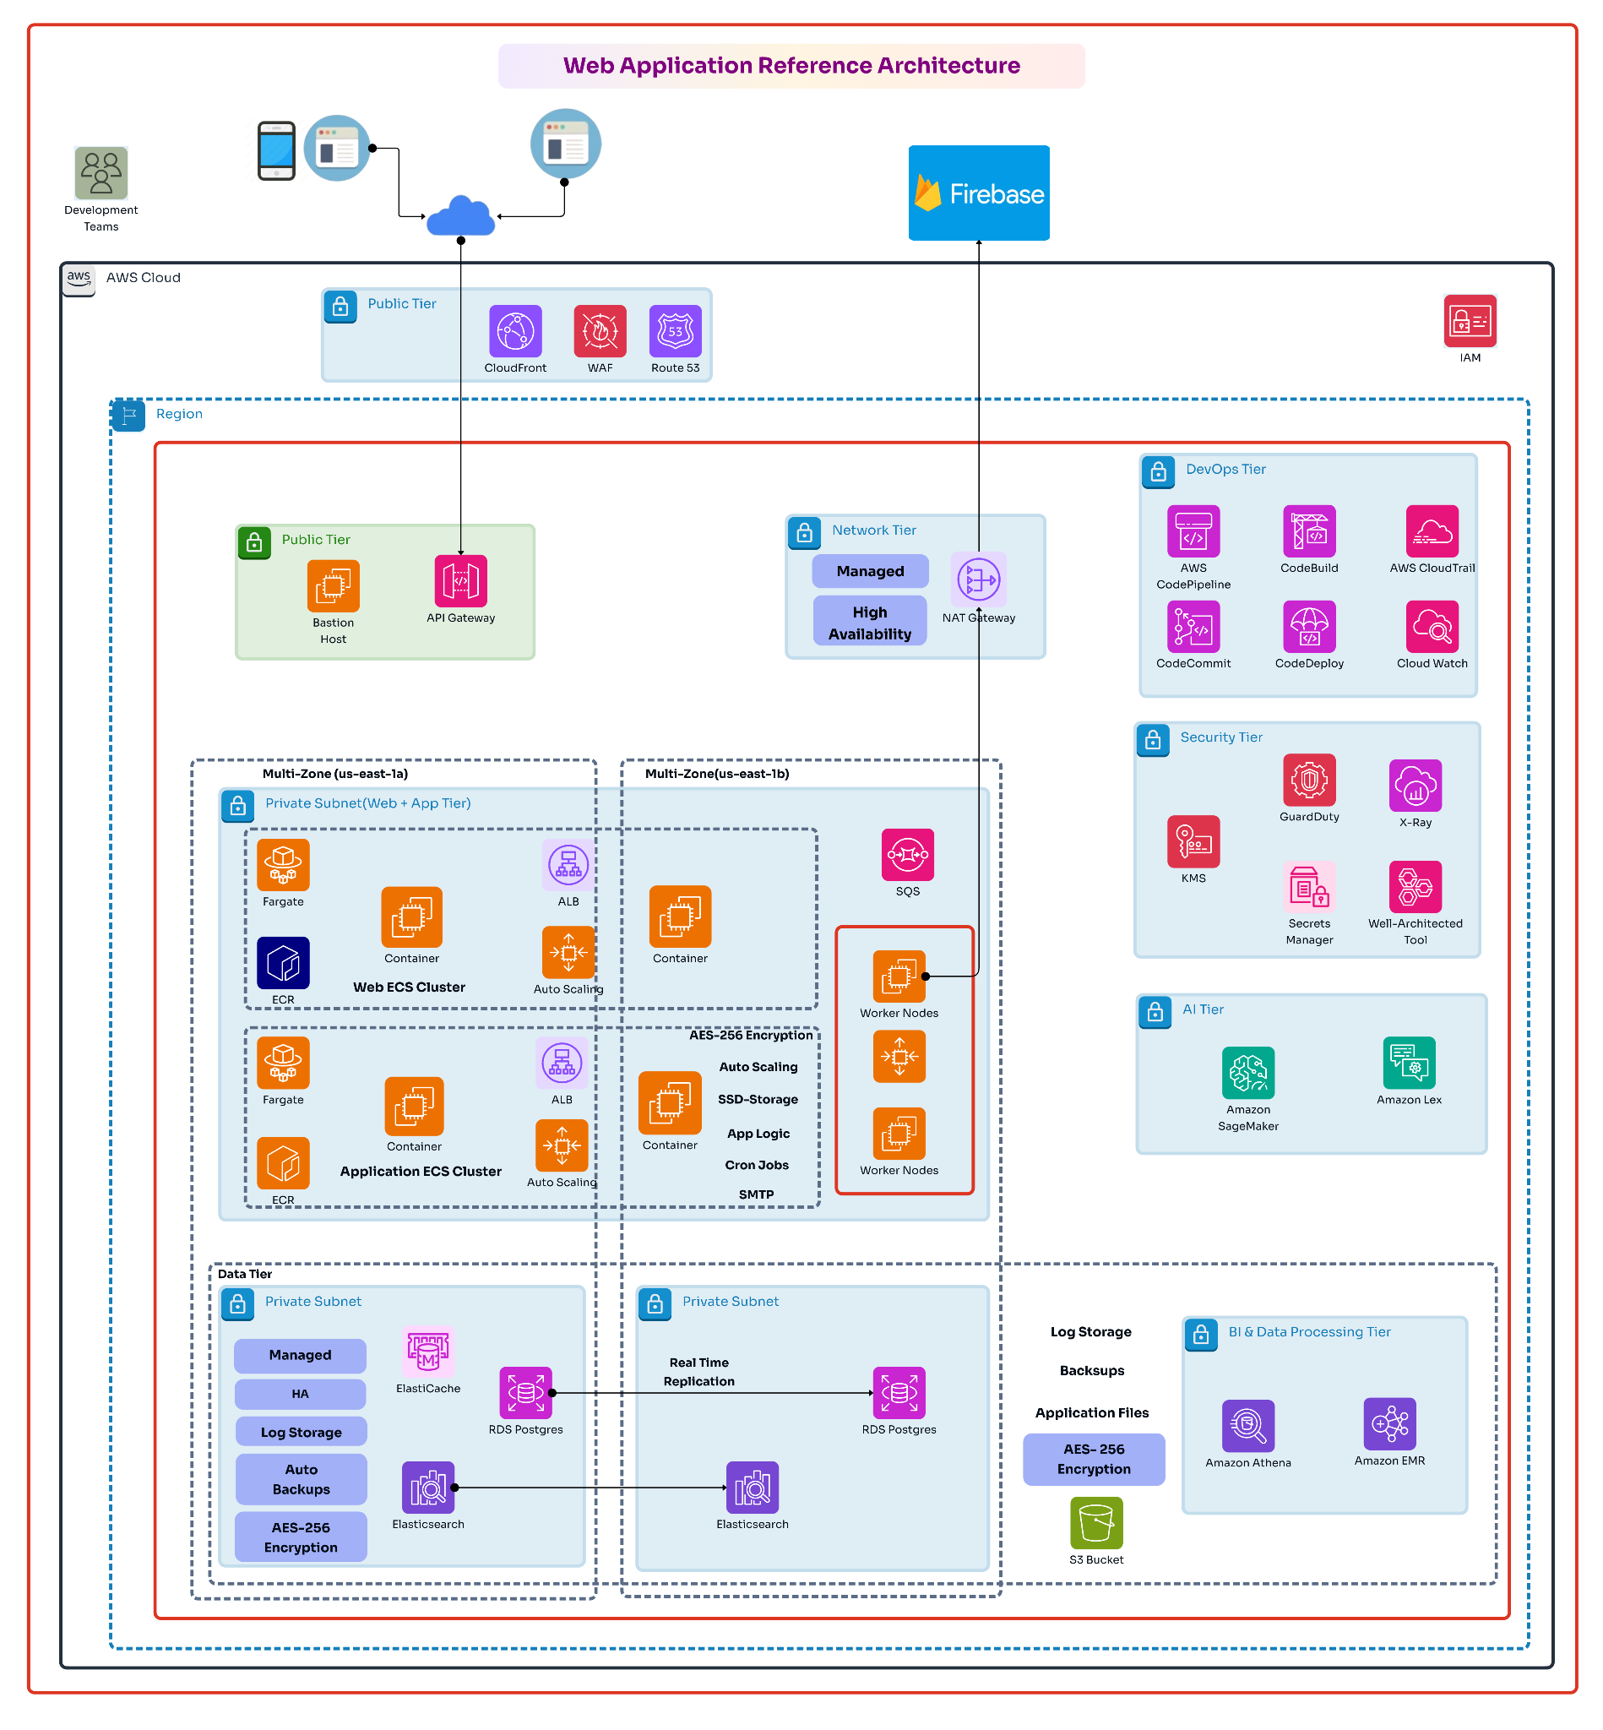
themodernsoftware.dev

Slide 6
The Old World
Responsibilities of SRE
Operational monitoring
on-call, troubleshooting, infrastructure management and security
Incident resolution involves piecing together info from many different sources and teams
Maintain oftentimes outdated runbooks for how to resolve issues
Shift to cloud-native architectures with containerized workloads and Kubernetes has introduced more data, dependencies, and complexity across systems
SREs often get burned out due to on-call shifts
themodernsoftware.dev
Notes:
estimates that downtime and service degradation cost the Global 2000 about $400 billion annually

Slide 7
Principles of Infrastructure and DevOps
Four golden signals of monitoring
Latency
Errors
Traffic
Requests/sec
Saturation
Monitor production traces
themodernsoftware.dev
Notes:
Latency: Measures how long it takes to service a request. Track both successful and failed requests separately, since failed requests (like HTTP 500s) can distort averages. Slow errors are especially concerning and should be monitored closely.
Traffic: Represents system demand, typically measured as requests per second or equivalent units depending on the system (e.g., sessions for streaming, transactions for databases).
Errors: The rate of failed requests, whether explicit (e.g., HTTP 500s), implicit (wrong content despite 200 OK), or policy-based (e.g., exceeding response-time commitments). Use multiple layers of monitoring to catch different failure types.
Saturation: Indicates how "full" your system is — tracking constrained resources like CPU, memory, or I/O. Systems often slow before hitting 100% utilization, so define safe thresholds. Monitor for signs of impending limits, such as rising latency or storage nearing capacity.

Slide 8
At 3:12 am you get a ping from PagerDuty that you’re seeing a spike in 500s on your database queries. What do we do?
themodernsoftware.dev
Notes:
What do we do? Ask for thoughts from the audience

Slide 9
A Potential Playbook
Acknowledge and assess
Check DB + app
Identify recent changes
Localize blast radius
Execute mitigations
Stabilize + monitor
Communicate
Document
themodernsoftware.dev
Notes:
Acknowledge & Assess
Acknowledge in PagerDuty
Confirm severity: check app + DB dashboards
Identify whether impact is partial or full outage
Check the Golden Signals (DB First)
Connections: maxed? stuck? sudden drops?
Latency: P95 spikes? slow queries?
Errors: timeouts? refused connections? aborted transactions?
Saturation: CPU, IOPS, locks, memory, replication lag
Look for What Changed
Recent deploy?
DB migration?
Config / feature flag change?
Autoscaling event? → Roll back / revert immediately if correlated.
Localize the Failure
All queries or specific ones?
Read vs write?
Primary vs replicas?
One shard/instance or all?
App side (pools/timeouts) vs DB side (load/locks)?
Apply Fast Mitigations
Connection issues: restart app pods, reduce concurrency
DB saturation: disable heavy jobs, throttle traffic, route reads to replicas
Bad/slow queries: disable feature/endpoint, enable cached/degraded mode
Replica lag: route reads to primary, restart replica
Unhealthy node: restart only replicas; escalate for primary
Stabilize & Monitor
Watch 500 rate, DB latency, and traffic normalize
Ensure no retry storms or cascading failures
Validate app health checks recover
Communicate
Brief updates: issue → action → current status
Update every 10–15 minutes during active incident
Close Out
Capture timeline
Identify root cause driver
Log follow-ups: query fixes, indexing, scaling, retry tuning, capacity review

Slide 10

themodernsoftware.dev

Slide 11
Metrics Tracked
Mean-time-to-repair (MTTR)
How many engineers are pulled into incident
Reported SLA for customers
themodernsoftware.dev
Notes:
Reported SLA is not explicitly tracked

Slide 12
The New AI World
Resolve AI (guest lecture 11/21)
DataDog Bits AI Agent
Splunk Observability Assistant
themodernsoftware.dev

Slide 13
Characteristics of an AI SRE
Dynamic mapping of a knowledge graph
Agentic system across observability stack and clouds
Generates real-time narratives of what is happening, pinpoints likely root causes with supporting evidence, and recommends prescriptive remediation steps
Heavy emphasis on explainability and auditability of predictions/reasoning
themodernsoftware.dev

Slide 14
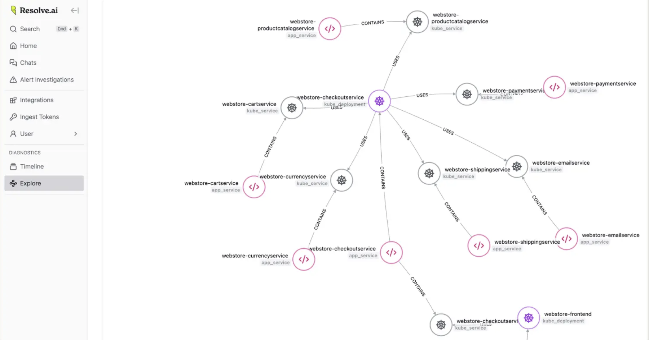
themodernsoftware.dev

Slide 15
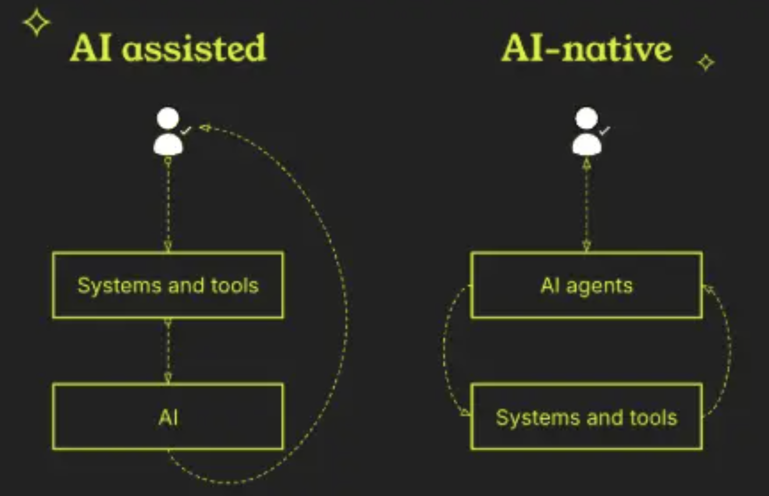
What Has Changed
AI promises to scale out organizational and service level knowledge
Information is not siloed to the only engineers who know the undocumented dependencies, brittle legacy services, and quirks that only surface during high-stakes incidents.
themodernsoftware.dev

Slide 16
What Has Changed
Automation reduces review time and catches issues early
Developers learn best practices through AI suggestions
AI applies the same standards across all code reviews
AI handles routine checks, letting humans focus on complex logic
AI systems improve over time with more data
modern AI code review tools go deeper, offering contextual analysis and pattern recognition
themodernsoftware.dev

Slide 17
Let’s See AI SRE in Action
themodernsoftware.dev
Notes:
Observability, working theories
SPan information
Heavily evidence-based
Chat for more dynamic querying of information

Slide 18
Limitations
Complexity of incidents that can be resolved
Heterogeneity of modern production stacks
Ability to remediate actual code based on what has been detected
Eventual goal though all providers are starting with root cause analysis
Good root cause analysis requires good monitoring gardening
Security could be a new attack vector
themodernsoftware.dev

Slide 19
Questions?
themodernsoftware.dev

